Slide 1
Brunswick Renewable Energy Center
November 3, 2011

Slide 2
Brunswick Renewable Energy Center Background
On August 22, 2005 the Federal Base Realignment and Closure (BRAC) Commission voted to close Naval Air Station Brunswick (NASB)
NASB is a 3,200 acre property located in the Midcoast Region of Maine with state-of-the-art facilities

Slide 3
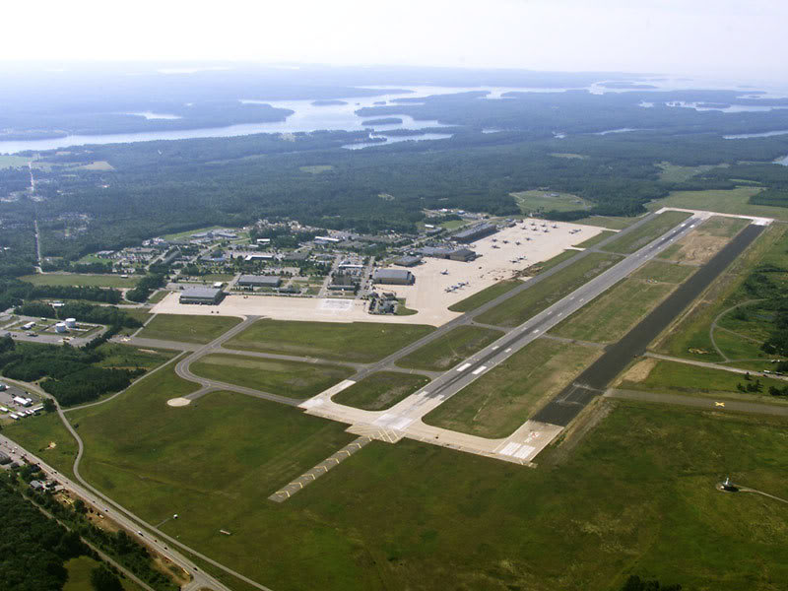
Brunswick Renewable Energy Center Background
World class aviation complex
Two 8,000 runways
Modern hangars and maintenance facilities
Brunswick Landing
(former NAS Brunswick)

Slide 4
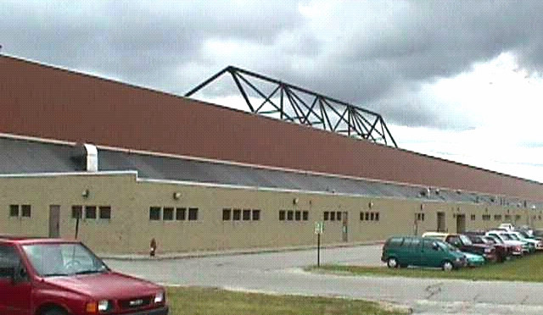
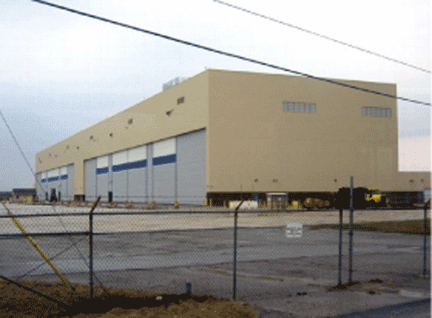
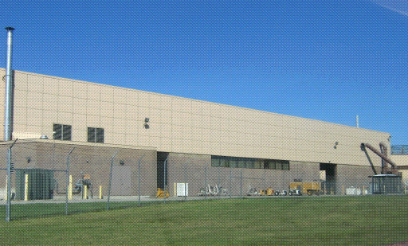
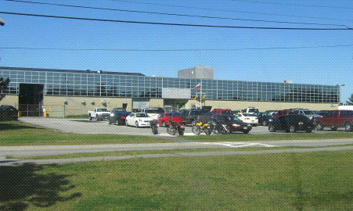
Brunswick Renewable Energy Center Background
Over 200 buildings totaling nearly 2 million square feet of commercial and industrial space (most less than 15 years old)

Slide 5
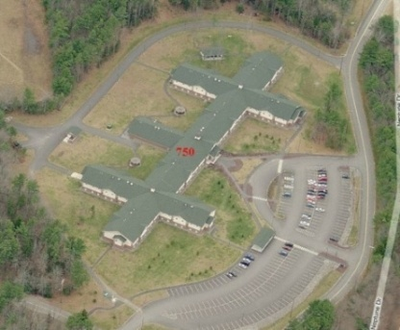
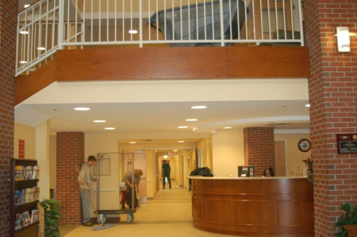
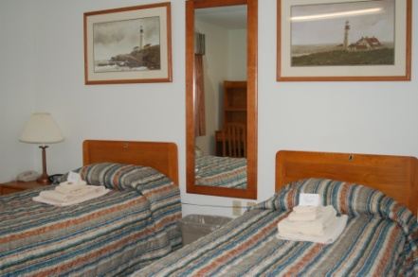
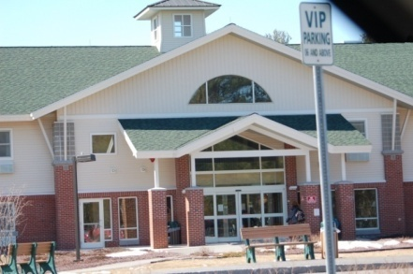
Brunswick Renewable Energy Center Background
Major IT assets including:
Single mode fiber optic network
Avaya Definity switch
Point of Presence for telephone switching
2nd largest hotel in Maine with 115,000 square feet and 250 rooms

Slide 6
Brunswick Renewable Energy Center Background
Midcoast Regional Redevelopment Authority (MRRA) is a non-profit, quasi-public organization established by Maine State Legislature to implement the Reuse Master Plan for NAS Brunswick

Slide 7
Brunswick Renewable Energy Center Background
Reuse Master Plan calls for business centers of excellence in advanced technologies for composites, IT, aerospace and renewable energy, and top notch educational facilities

Slide 8
Brunswick Renewable Energy Center Background
MRRA is committed to redeveloping NAS Brunswick a way that creates:
vibrant live, work, learn, and play environment
centers of excellence for technology innovation, environmental sustainability, and “green” community development
variety of corporate, business, academic, recreational, and community services
strong sense of place based on smart growth principles

Slide 9
Brunswick Renewable Energy Center Background
Targeted business sectors for redevelopment:
Aviation
Composite Materials
Information Technology
Education
Alternative Energy
Tourism

Slide 10
Brunswick Renewable Energy Center Background
Key components of MRRA’s redevelopment plan and business attraction efforts include:
Southern Maine Community College (SMCC) Midcoast Campus and associated Maine Advanced Technology Center (MATC)
Brunswick Renewable Energy Center (REC)

Slide 11
Brunswick Renewable Energy Center Background
Southern Maine Community College
Maine Advanced Technology Center (MATC)
Dedicated labs, classroom space, and application shops for manufacturing and composites training
Will train workers in skills required to succeed in high-growth, high-demand industries:
Advanced Manufacturing
Composites Training
MATC will drive the advancement of the manufacturing industry, and make Maine and Brunswick Landing an attractive place for companies looking to expand or relocate

Slide 12
Brunswick Renewable Energy Center Concept & Vision
As part of the overall redevelopment strategy in the Reuse Master Plan, MRRA is:
Pursuing development of a renewable energy center (REC) at Brunswick Landing (NASB)
Focusing on green industries - industries that have potential to put Brunswick Landing at epicenter of emerging alternative energy market

Slide 13
Brunswick Renewable Energy Center Concept & Vision
Maine is already building strong base of renewable energy businesses
The creation of a Renewable Energy Center at Brunswick Landing provides an opportunity to:
Establish and grow a new technology cluster in Maine around renewable energy
Develop and deploy lower cost , “green” energy sources for the property (competitive advantage) on our own “smart” microgrid

Slide 14
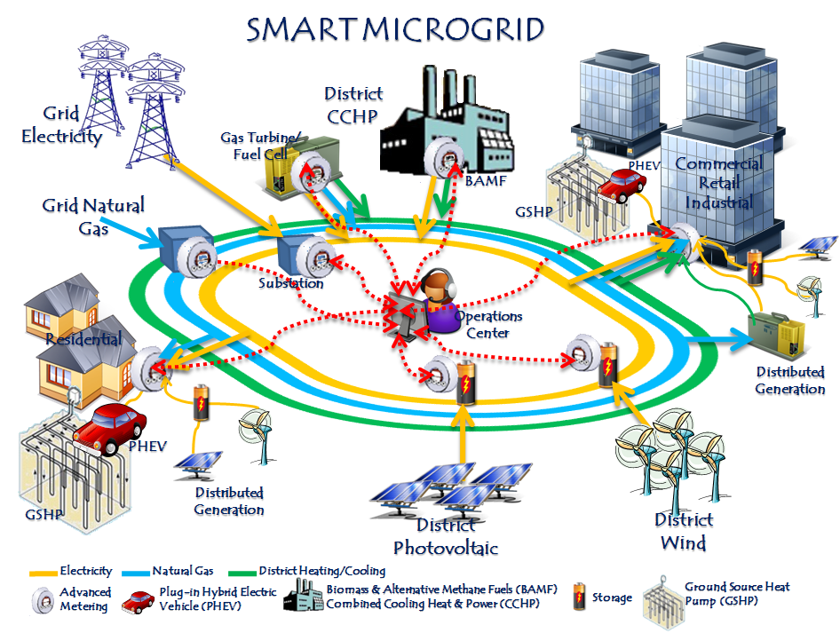
Brunswick Renewable Energy Center Concept & Vision

Slide 15
Brunswick Renewable Energy Center Concept & Vision
The Renewable Energy Center at Brunswick Landing is envisioned to be:
Center of Excellence for alternative energy research, development and demonstration
World-renowned living laboratory for integrated R&D, manufacturing, and operation of “next generation” green energy technologies

Slide 16
Brunswick Renewable Energy Center Feasibility Assessment
Feasibility Study for development of the BREC has been funded by grants from the Economic Development Administration and the Maine Technology Institute and funding from EPA (Task 2)
Study consists of five phases:
Infrastructure and Site Analysis
Renewable Generation Opportunities
Identification of Technology Partners
Operational Management Needs and Next Steps
Implementation

Slide 17
Brunswick Renewable Energy Center Strategic Study Partners
Task 1
Task 2
Task 3
Task 4 – E2Tech and Others

Slide 18
Brunswick Renewable Energy Center Feasibility Assessment
Status
Wright-Pierce has completed Task 1
NREL has completed Task 2
MRRA is now working with E2Tech on Task 3 and some Task 4 activities

Slide 19
Brunswick Renewable Energy Center Next Steps
Results to date are extremely positive
Existing utility infrastructure will support development of Renewable Energy Center at Brunswick Landing
NREL has identified renewable energy generation technologies that can be cost effectively deployed in the near-term

Slide 20
Brunswick Renewable Energy Center Other Related Activities
Fraunhofer Center for Sustainability
“Build America” program
Exploring potential demonstration project for residential “deep energy retrofits”
Cleantech Innovation New England
Development of clean tech corridor in Maine
i6 Green award to accelerate cleantech startups
Along with MTI, E2Tech, and UMaine; MRRA is part of collaborative put together by New England Clean Energy Foundation

Slide 21
Brunswick Renewable Energy Center Summary
The Brunswick Renewable Energy Center can:
Attract energy technology businesses in conjunction with on-site, alternatively-fueled energy production and “smart microgrid” distribution facilities
Provide dynamic power production and distribution infrastructure to allow “plug and play” of new technologies on a “smart” microgrid
Make Brunswick a national center for renewable energy technology
Create new and sustainable “green” job opportunities
Provide low-cost, green energy for business development

